Slide 1
Enabling technology
Enabling what and for whom?

Slide 2
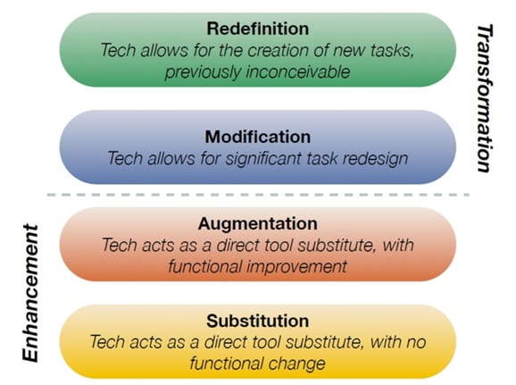
This workshop…
We will use ICT-tools for specific purposes.
We want to transform the way we do things using technology.

Slide 3
Ortographic depth
The orthographic depth indicates the degree to which a written language deviates from simple one-to-one letter–phoneme correspondence.
How easy is it to predict the pronunciation of a word in your language based on its spelling?
Shallow orthographies are easy to pronounce based on the written word, and deep orthographies are difficult to pronounce based on how they are written.

Slide 4
DEEP
The orthography organizer
Shallow

Slide 5
DEEP
Shallow
The orthography organizer

Slide 6
Danish example
-og-
Han tog dog et tog med en log og drog til sin toga loge.
Direct translation: He took, however, a train with a log and went to his toga lodge.

Slide 7
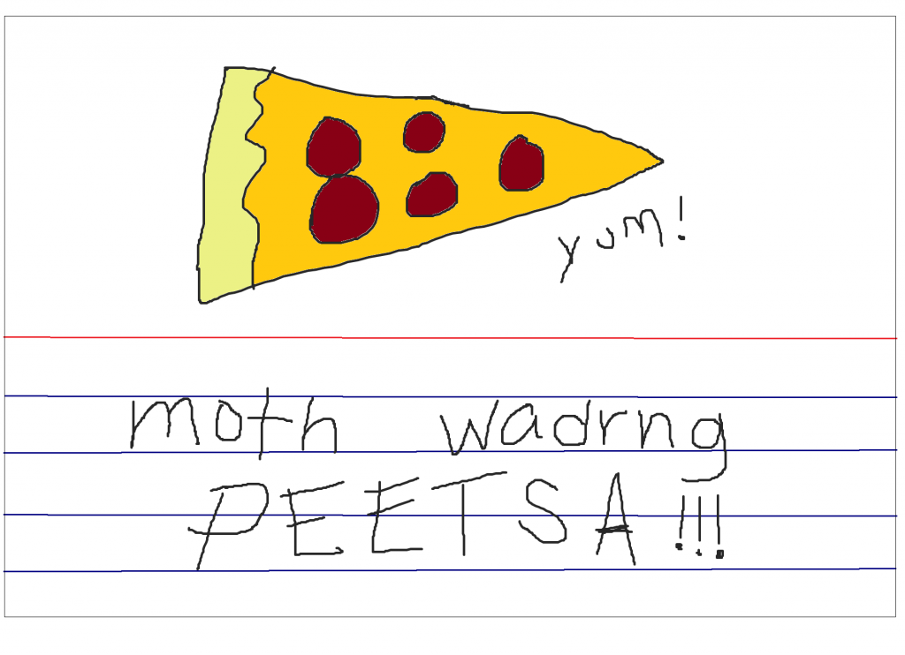
Supporting orthographic correctness with technology
In deep orthographies we use invented spelling a lot.
Invented spelling allows students to use unconventional spellings of words in the early stages of their literacy development.
Students write meaningful texts using words they don’t know how to spell – writing the letters that correspond to sounds that they can ‘hear’.
Do you use this in Italy and Finland?

Slide 8
Challenges
The deeper the orthography, the further students’ invented spelling will be from correctness.
If students are to learn correct spelling they will need feedback from their teacher.
Using invented spelling students can write truckloads of text.
Hence, we need students to be able to correct their texts independently (as far as they can).

Slide 10
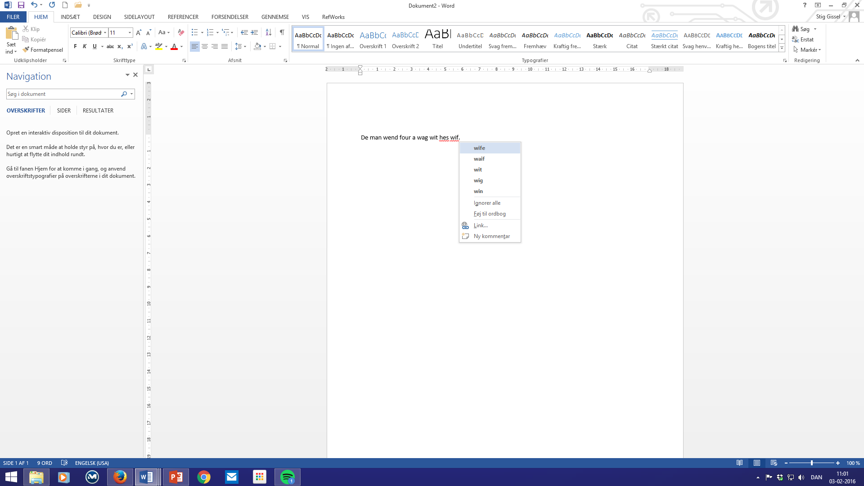

Slide 11
Do you have a program like this at your school?
Click the image to go to a video presenation

Slide 13
Suggestions for use
Let students write their text using invented spelling without using word suggestions.
This makes students focus on meaning.
Afterwards the student can (depending on skill level) either
Read through the text looking for misspellings, activating support only if needed.
Listen to each sentence being read aloud by the program to discover if there are words missing, wrong syntax or misspellings.
Browse through the text word for word and checking spelling with the tool.

Slide 14
Supporting reading
Again, in deep orthographies we are challenged.
Normally, in the primary grades we have either:
Phonics based learning materials with highly controlled vocabulary or
Graded books, that students read individually
Neither is optimal…

Slide 15
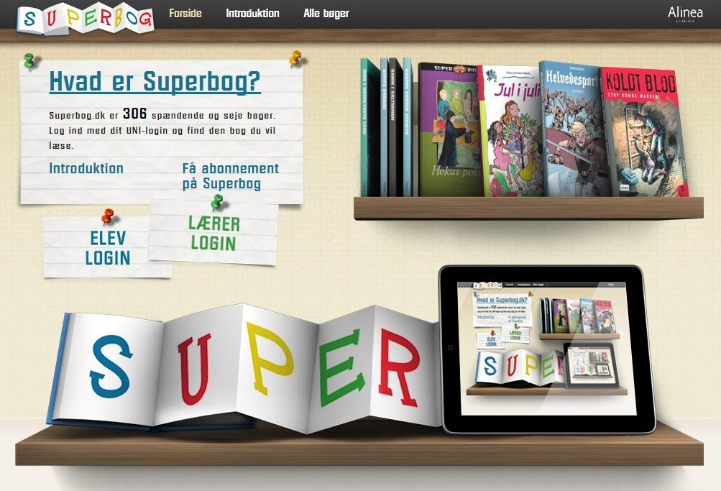
Talking books
Digital texts with text-to-speech support.
If students cannot read a word independently, they can have it read aloud.

Slide 16
Single word reading
Whole page reading

Slide 17
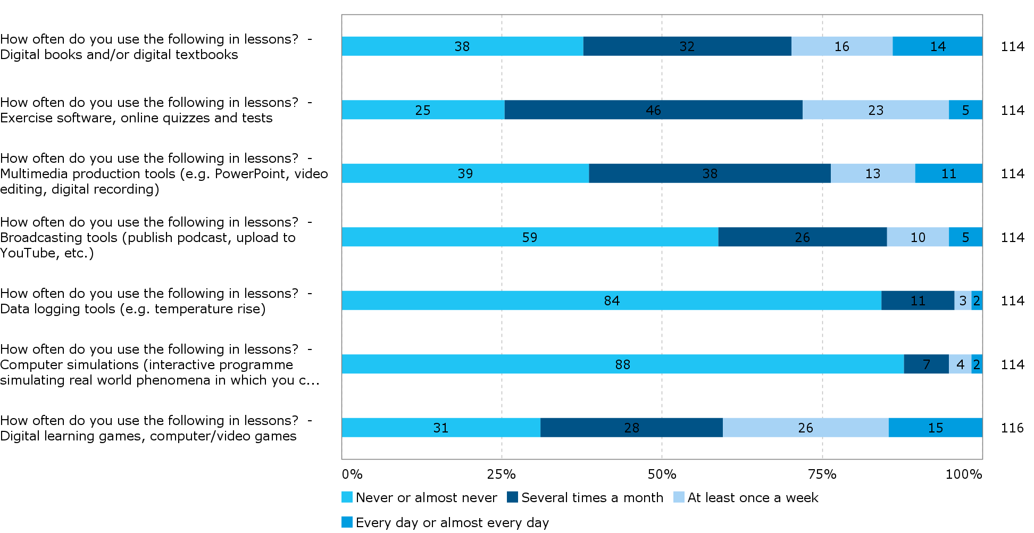

Slide 18
Suggested use
The whole class reads the same text in the talking book-software.
The text is deliberately chosen so it would NORMALLY (i.e. without the support) be considered (a little) too difficult for many students.
This means that students will need the TTS support.
Students are instructed to try to read the words independently before using the TTS-support.
The teacher has to work with activating students’ prior knowledge to make them focus on the narrative/understanding – and talk about the meaning of the text after reading.

Slide 19
Older students…
Why not let students use text-to-speech when reading a text for biology, physics or language studies?
The big question: Should textbooks challenge students? If so, in what respect?
My answer: Of course students have to learn to read (i.e. decode) difficult texts independently. But sometimes we have to take pressure of their (lacking) reading skills, and let students access the meaning and focus on learning the subject, more directly.

Slide 20
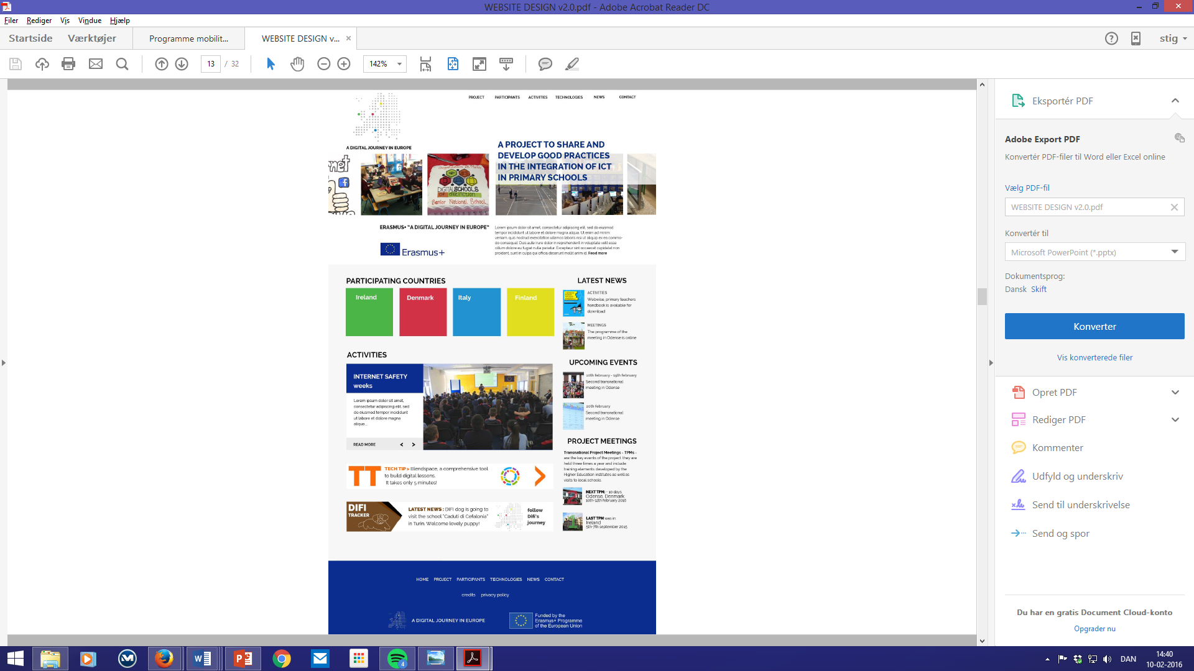

Slide 21
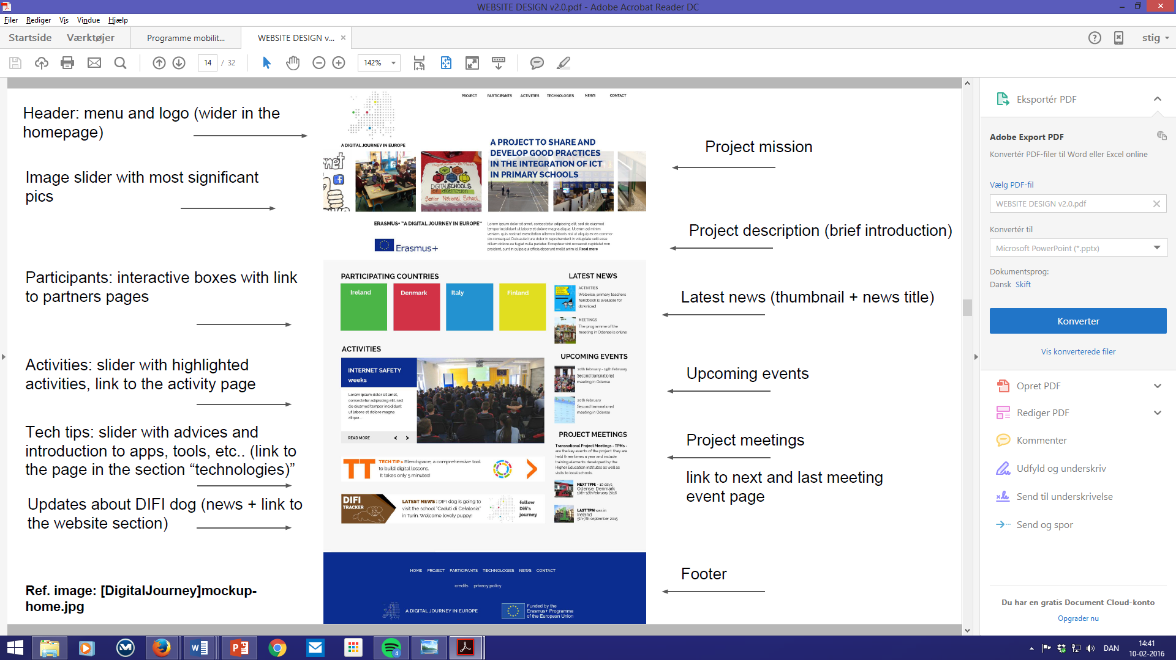

Slide 22
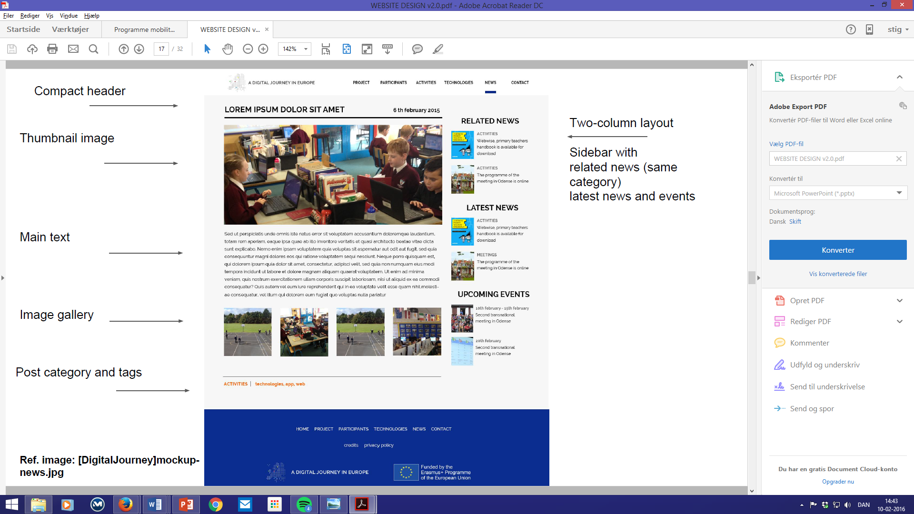

Slide 23
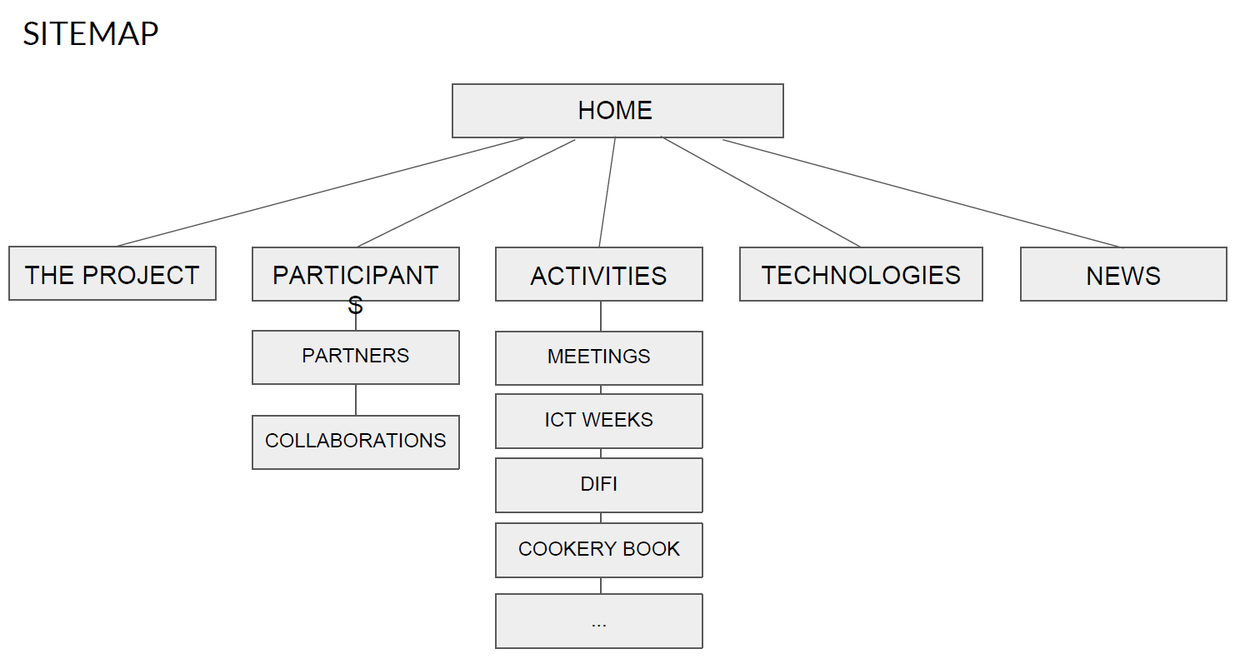

Slide 24
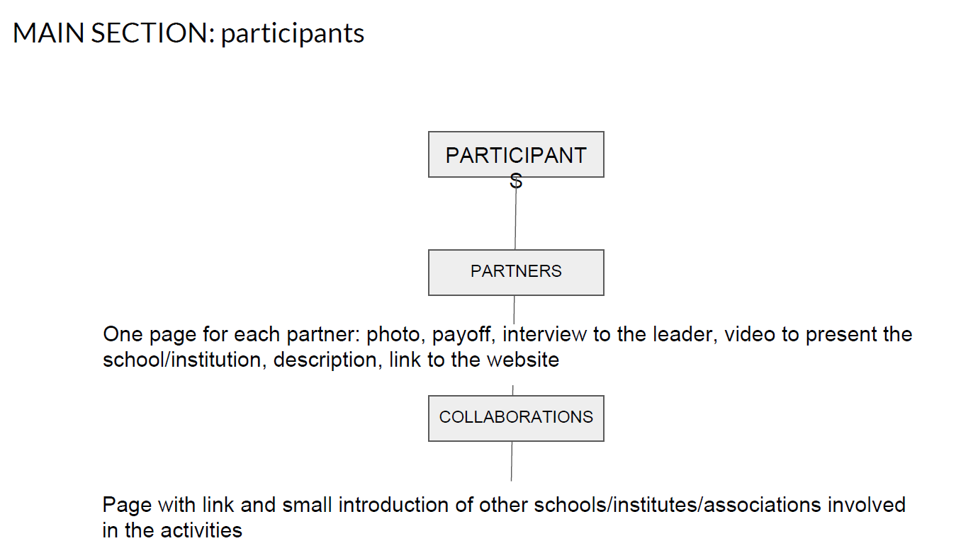

Slide 27
IMAGE ARCHIVE
Let’s create an archive of photos, videos and any material related to the project activities and to the partners that can be published in the website and used in documents, slides, presentations…
Photos depicting: school activities, students and technology, pupils using devices, drawings and project materials, events, school buildings and spaces, etc ...
Each image uploaded must contain the indication of the activity/event/place/date in the file name.
Upload the photos in the shared folder of Google Drive WEBSITE > IMAGE ARCHIVE (create one folder for each partner organized in subfolders) link: https://drive.google.com/open?id=0B4uULFjpOEpMVmgwelBnMkh5TWM

