Slide 2
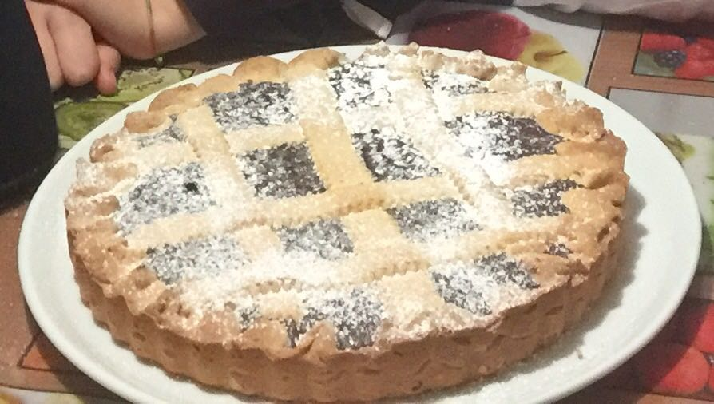
PIE WITH «BISCHERI»
A typical sweet of Pisa city
ITALIAN RECIPE

Slide 3
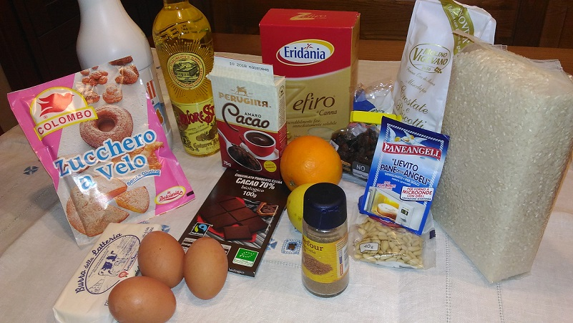
INGREDIENTS
ITALIAN RECIPE

Slide 4
INGREDIENTS
For a baking tin of 24/26 cm
300g white flour
150g powdered sugar
125g butter
1 whole egg and 1 egg yolk
1 orange (grated peel)
ITALIAN RECIPE

Slide 5
INGREDIENTS
Liquor strega: ½ coffee cup
A teaspoon of yeast (or bicarbonate)
½ litre of milk
100g rice (for soup)
1 egg
120g sugar
ITALIAN RECIPE

Slide 6
INGREDIENTS
80g dark chocolate
20g unsweetened powered cocoa
100g raisin
40g pinenuts
nutmeg
1 lemon (grated peel)
ITALIAN RECIPE

Slide 7
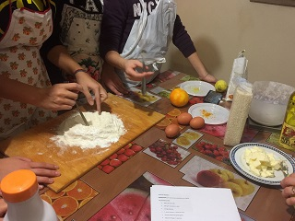
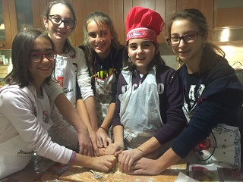
PREPARATION SHORT PASTRY
Put the flour and the sugar into a pastry board, make a well in the flour and put in the center the butter cut into small cubes; add all the remaining ingredients and knead the dough with your hands until it becomes an uniform ball. Wrap the pastry in cling film and store it in the fridge for one hour.
ITALIAN RECIPE

Slide 8
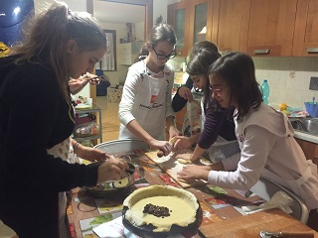
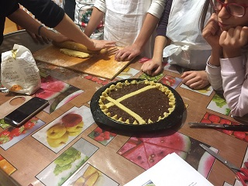
PREPARATION STUFFING
Soak raisins in liquor. Toast the pinenuts for few minutes. Cook the rice in the milk with the lemon grated peel; still worm add the dark chocolate, cocoa, sugar and mix all. Allow to cool, add all the other ingredients and stir the mixture.
ITALIAN RECIPE

Slide 9
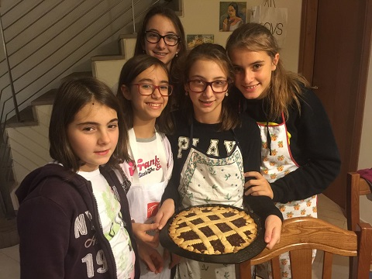
FINAL PREPARATION
Roll out the short pastry. Fill the mixture into the baking tin. Make some decorative strips. Fold the edges of short pastry, making some little tips, called «BISCHERI». Cook in the oven at 160°c for about 50 minutes.
ITALIAN RECIPE

Slide 10
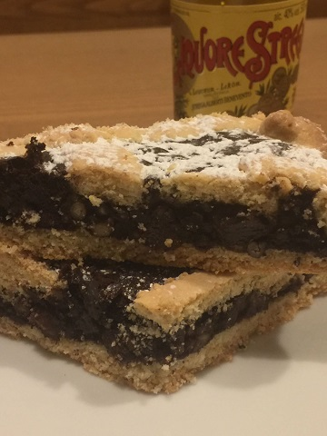
WELL DONE!
Dust with powdered sugar and enjoy your pie.

