Slide 2
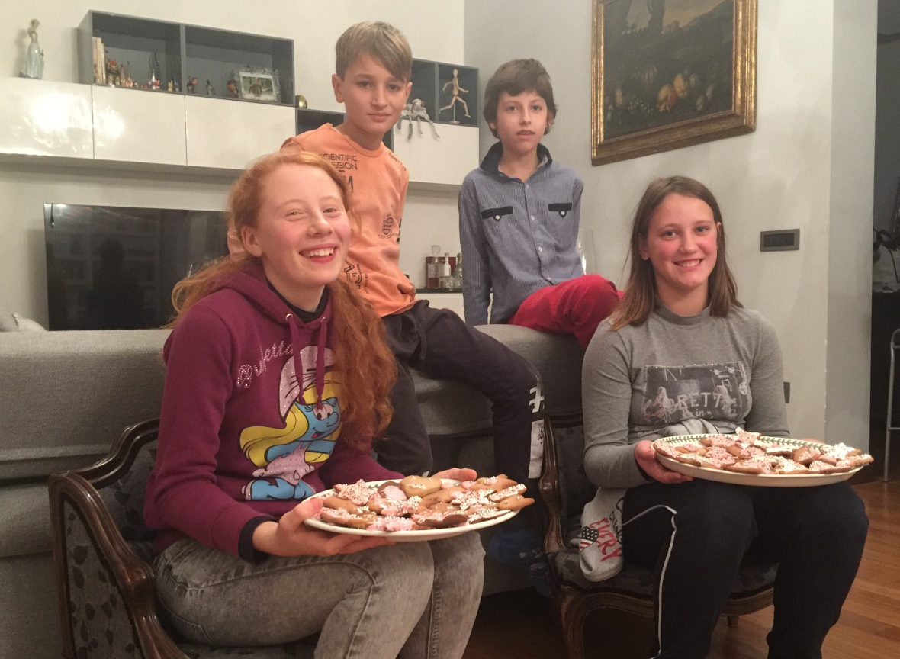
RECIPE
GINGERBREAD BISCUITS
Gaia Costa
Lera Manfrin
Augusto Baratti
Matias Marchetti
ITALIAN RECIPE

Slide 3
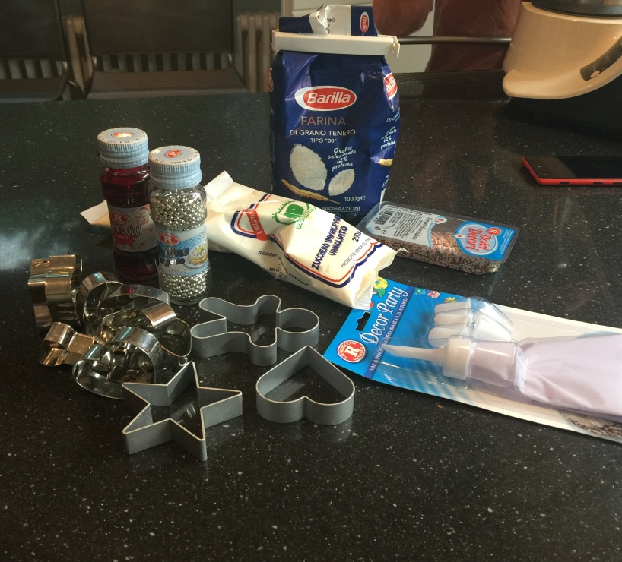
INGREDIENTS
00 Flour 350g
Sugar 160g
Butter 150g
1 egg
Fine salt 1 pinch
Honey 150 g
2 teaspoons ground ginger
2 teaspoons ground cinnamon
Nutmeg 1 pinch
½ teaspoon baking soda
Ground cloves
FOR THE ICING
• Food coloring to taste
• Icing sugar 150g
• 30 g egg whites
0gflour 350gflour 350g
00
ITALIAN RECIPE

Slide 4
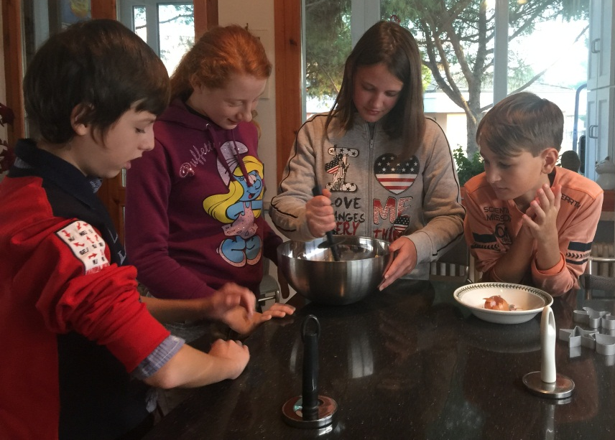
PREPARATION (1)
In a large bowl, or in the jar of the mixer sift the flour with the sugar, add the spices and baking soda and at the end the cold butter cut into small pieces.
Also add honey and operate at medium speed
until mixture is crumb. Finally combine also the egg and knead a few moments until you get a ball.
ITALIAN RECIPE

Slide 5
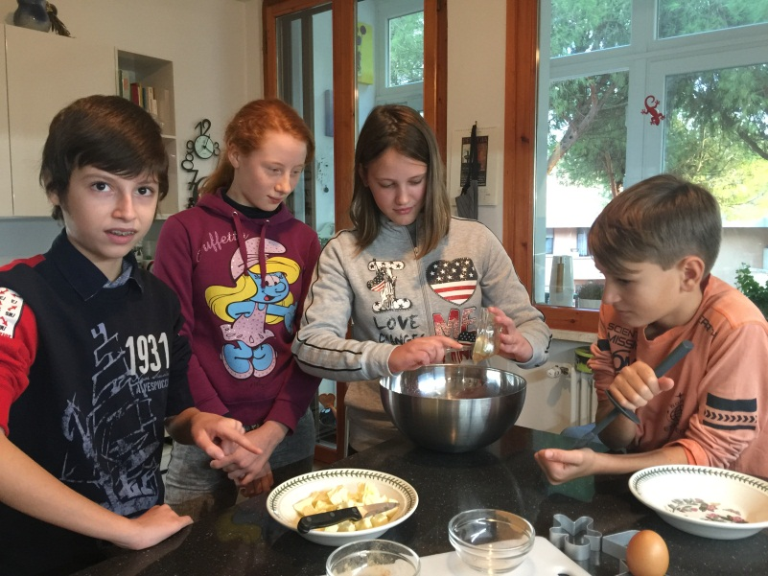
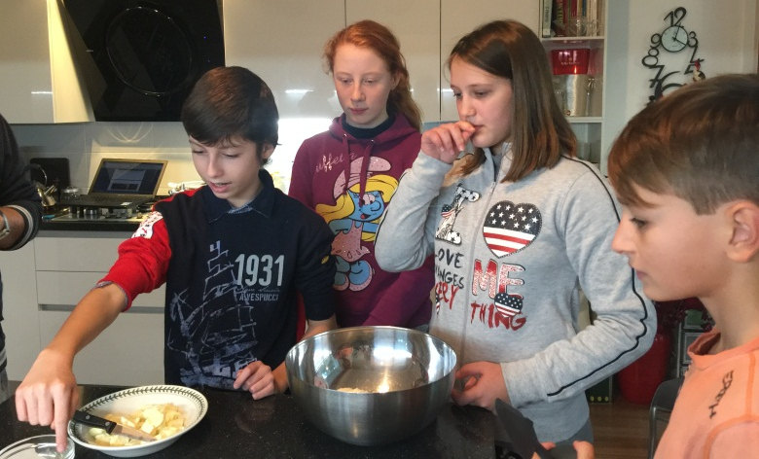
PREPARATION (2)
Wrap the gingerbread dough in a clingfilm and place it in the refrigerator for about 2 hours. Later on, roll out the dough using a rolling pin obtaining a flat layer about 4 mm thick. Prepare and cut the layer using different Christmas shapes, place on a baking sheet covered with parchment paper and put into a
ITALIAN RECIPE

Slide 6
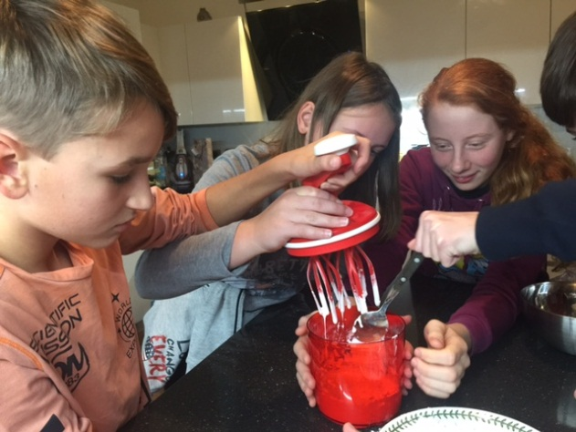
FINAL PREPARATION
ICING
Preheated oven at 180 degrees for about 10-12 minutes, until the biscuits will become gold or brown.
Meanwhile, prepare the frosting by mounting the egg white until stiff and incorporating little by
little, always beating, the icing sugar. Divide the icing into many bowls, add colors you want….after that, use the coloured cream to dress the biscuits as you prefer.

Slide 7
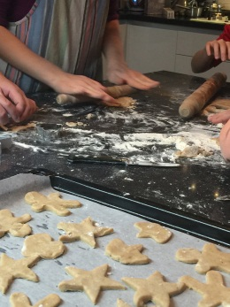
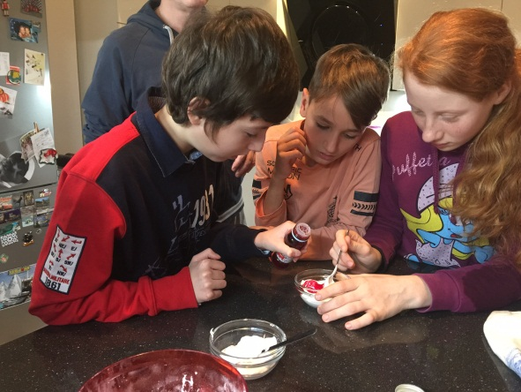
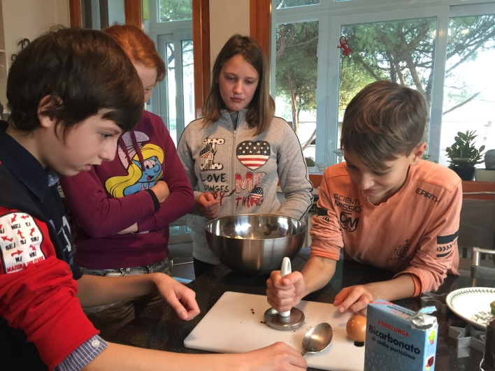
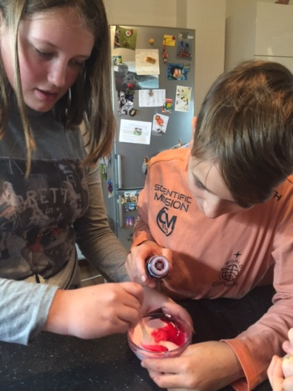
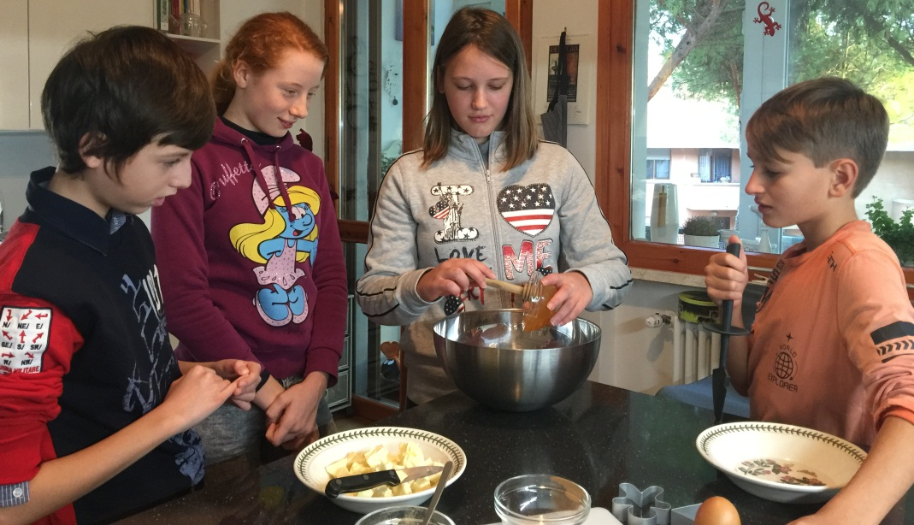
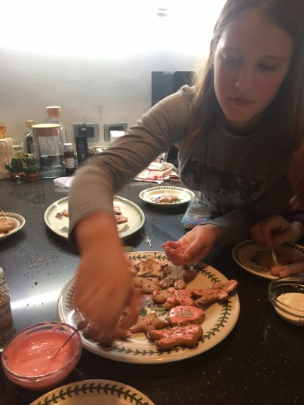
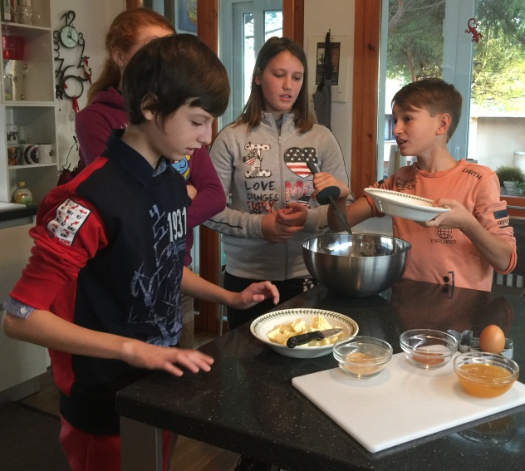
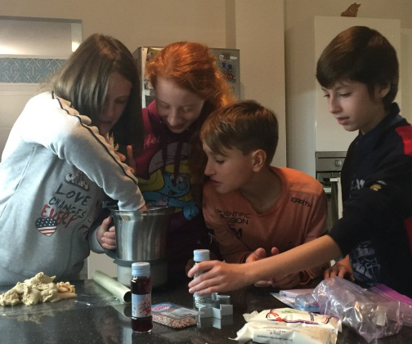
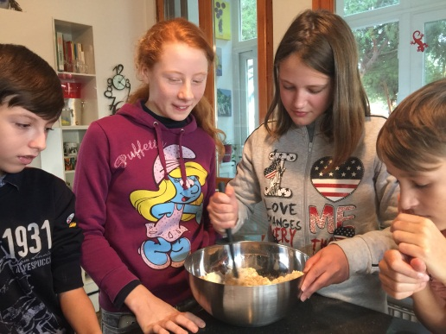
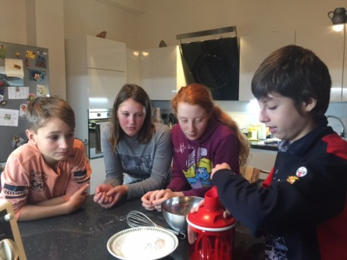
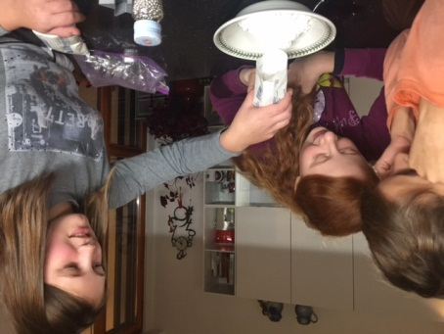
WELL DONE! WELCOME!

