Slide 2
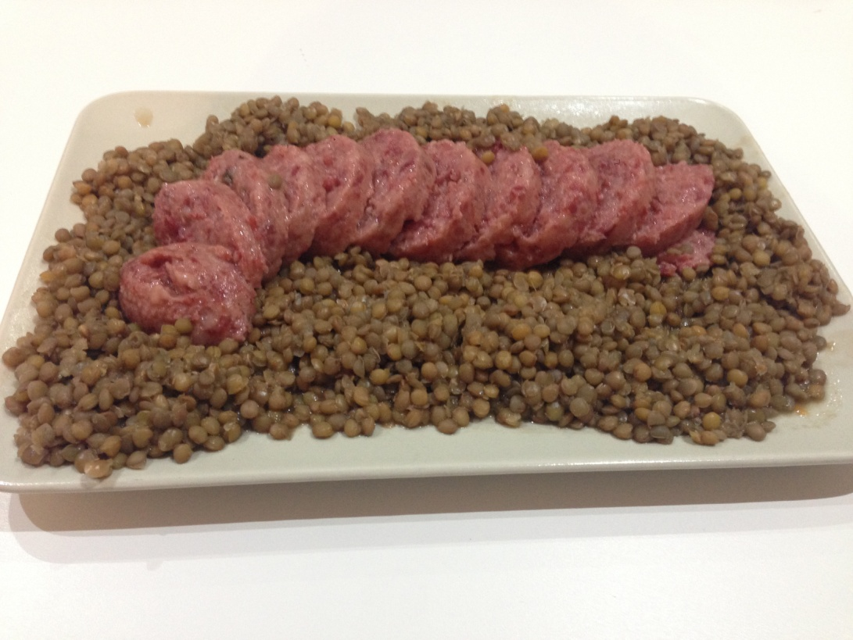
RECIPE
Lentil and Cotechino is a traditional New Year’s Eve serving. Have a portion of it before midnight is a wish of “good luck” for the new year coming.
ITALIAN RECIPE

Slide 3
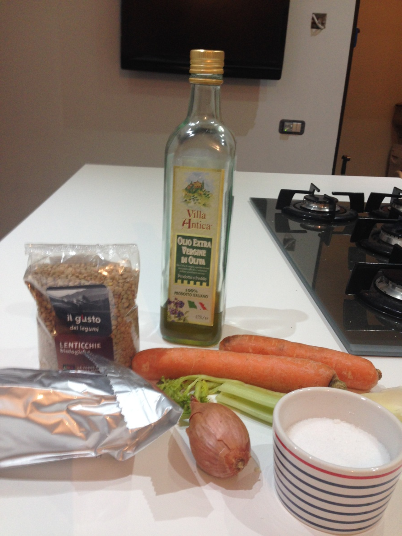
INGREDIENTS
8-10 servings
2 carrots
1 stalk of celery
1 onion
2 teaspoon of salt
1 tablespoon of olive oil
1 packed cotechino
500 gr of lentils
ITALIAN RECIPE

Slide 4
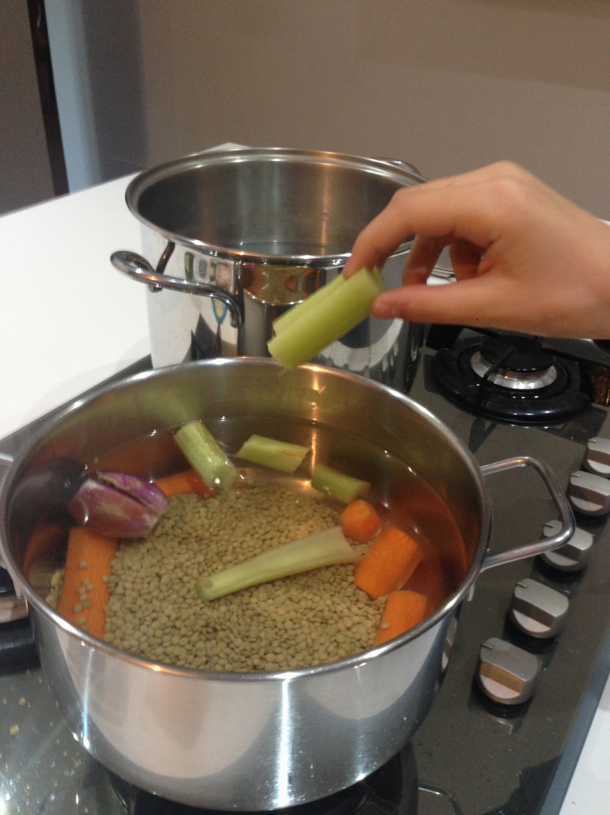
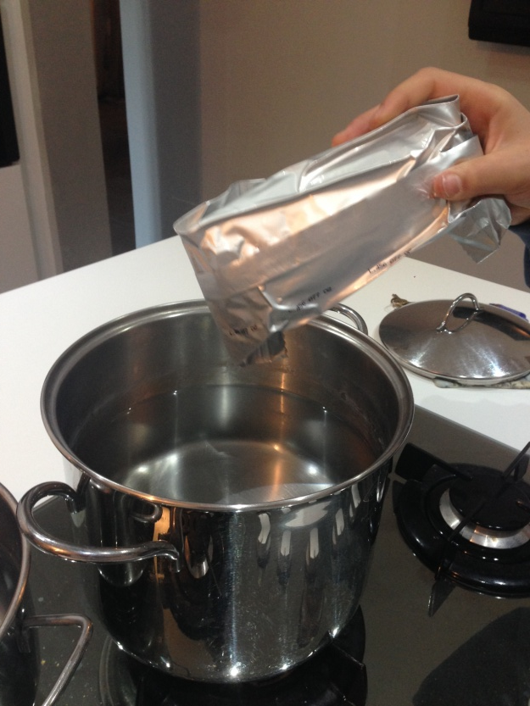
PREPARATION
Fill a deep pan with water, cut into big pieces
onion, carrot and celery. Add lentils, oil and salt
and cook for 40-45’.
In a different pan
let cotechino boil
in its aluminium
pack for 15-20’.
ITALIAN RECIPE

Slide 5
FINAL PREPARATION
Spread all the lentils on a plate.
Cut the cotechino in slices and lay
it down on the lentils.
Serve it hot!
ITALIAN RECIPE

Slide 6
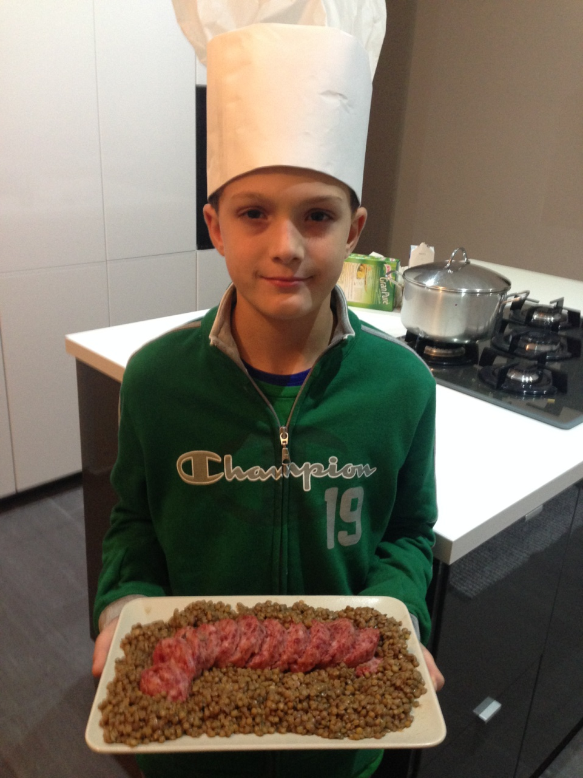
WELL DONE!
INSERT

