Slide 1
Chocolate salami

Slide 2
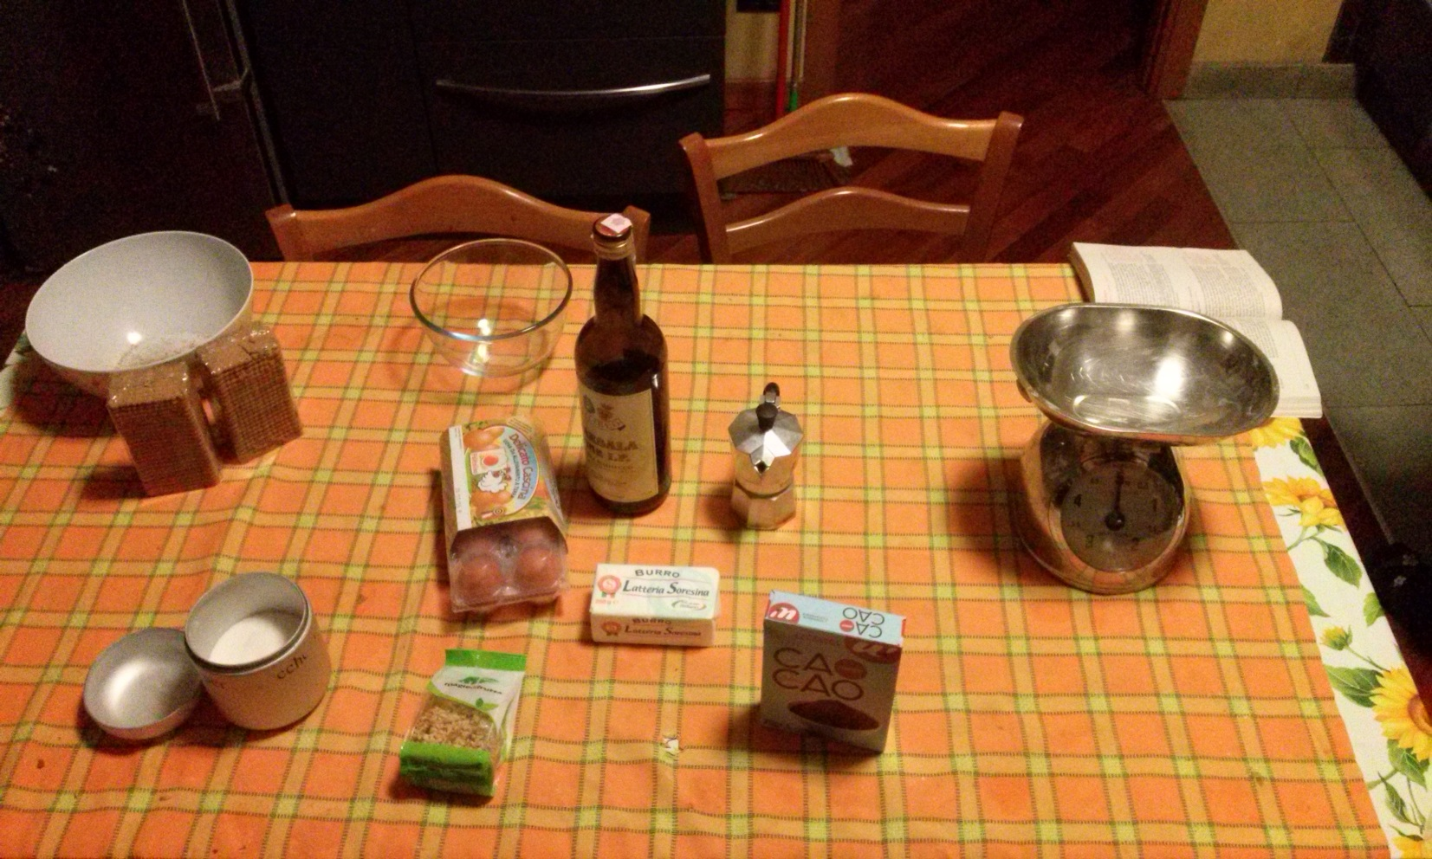
Ingredients:
one egg
Dry biscuits: 250 gr
Sugar: 125 gr
Butter: 250 gr
Bitter cocoa: 150 gr
Chopped nuts: 125 gr
Coffee: one small cup
Marsala liquor: one small glass

Slide 3
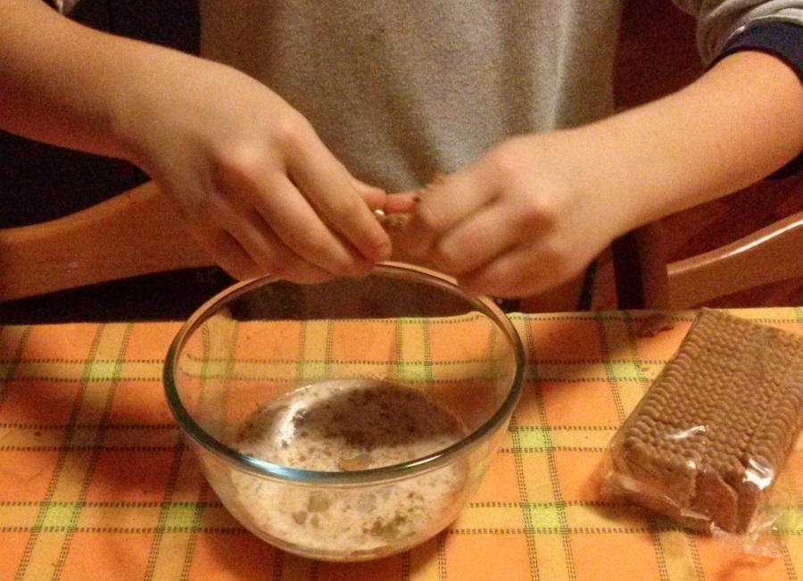
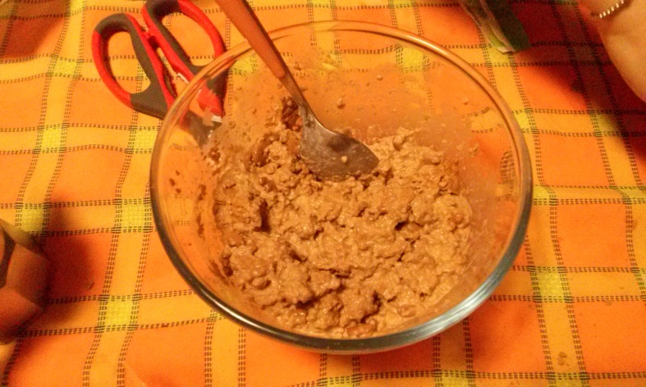
Crumble biscuits within coffee and liquor

Slide 4
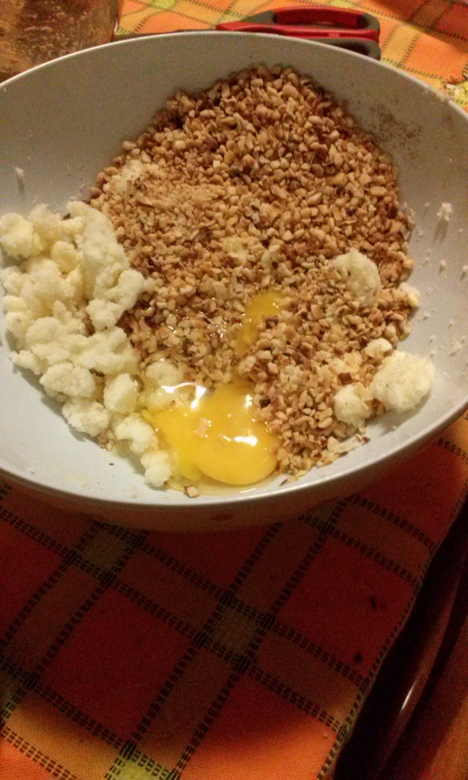
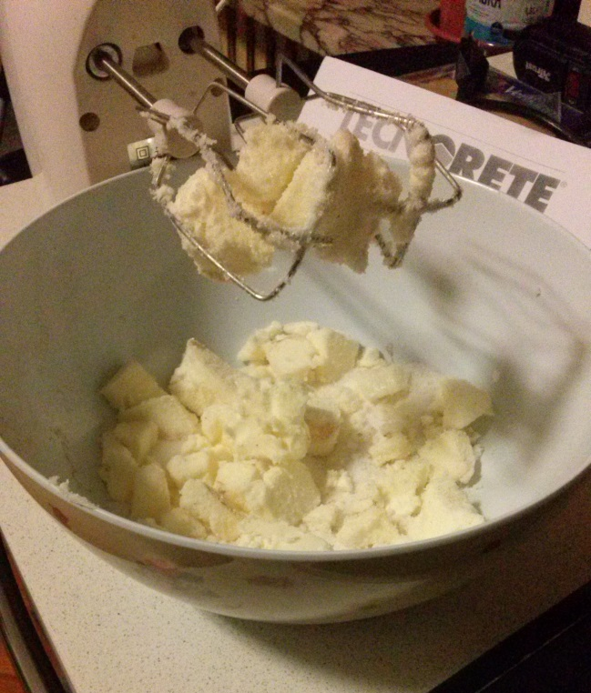
Mix butter and sugar
Add chopped nuts and the egg

Slide 5
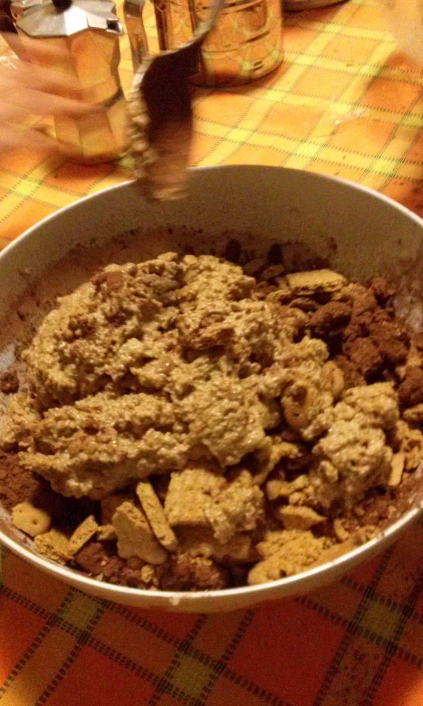
Mix all together with the hands

Slide 6
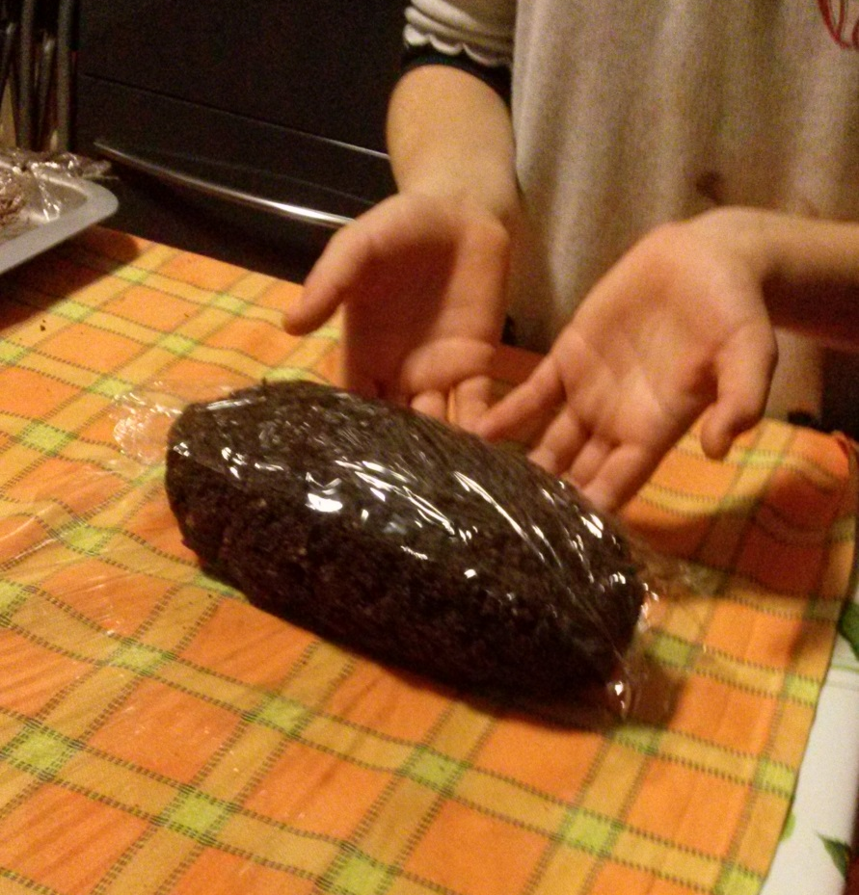
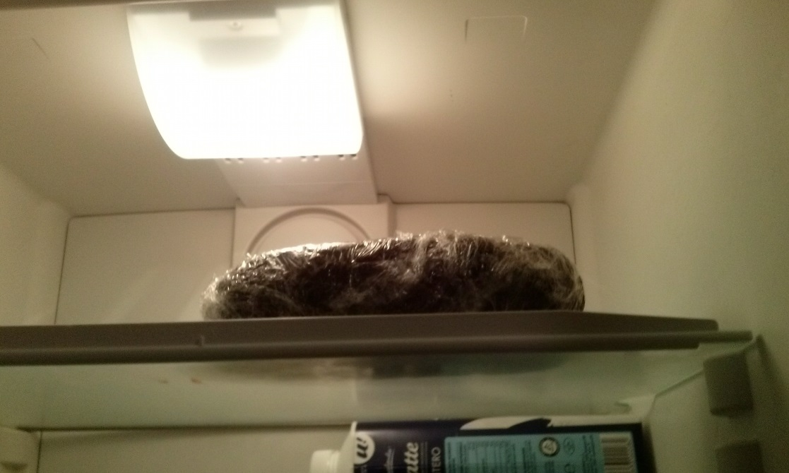
Shape like a salami
and wrap.
Put it in the fridge for 12 hours

Slide 7
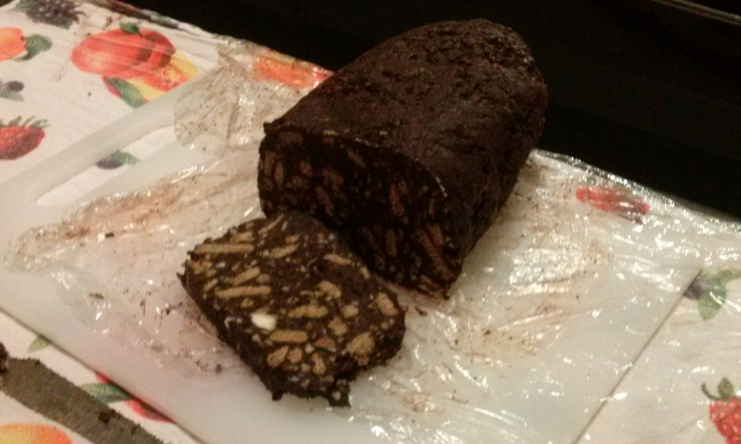
Enjoy your salami!

