Slide 1
«BONET»
The recipe to prepare a traditional «Piemontese» pudding

Slide 2
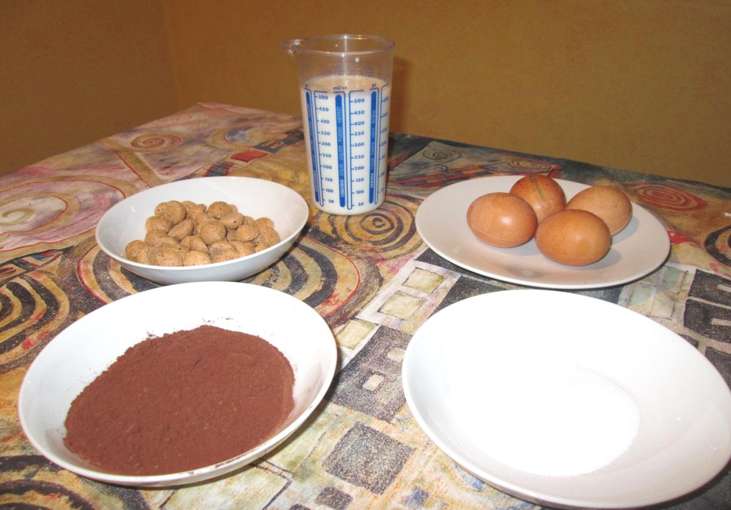
INGREDIENTS
4 eggs
500 ml of milk
60 g of unsweetened
cocoa powder
100 g of sugar
60 g of amaretti
caramel (50 g of sugar)
hazelnuts

Slide 3
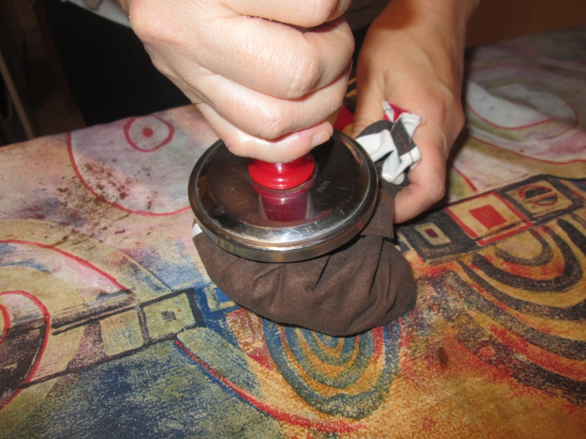
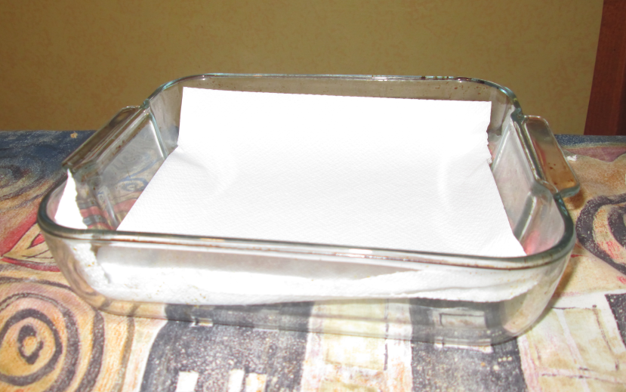
PROCEDURE
Crumble the amaretti
and put two or three paper
napkins on the bottom of
the heat-resistent dish

Slide 4
Then use a whisk to mix the sugar and the eggs

Slide 5
Add the cocoa and the crumbled amaretti

Slide 6
Pour the milk using the whisk

Slide 7
Prepare the caramel using 50 g of sugar and two spoons of water into a pan. When sugar changes colour pour it in the mould

Slide 8
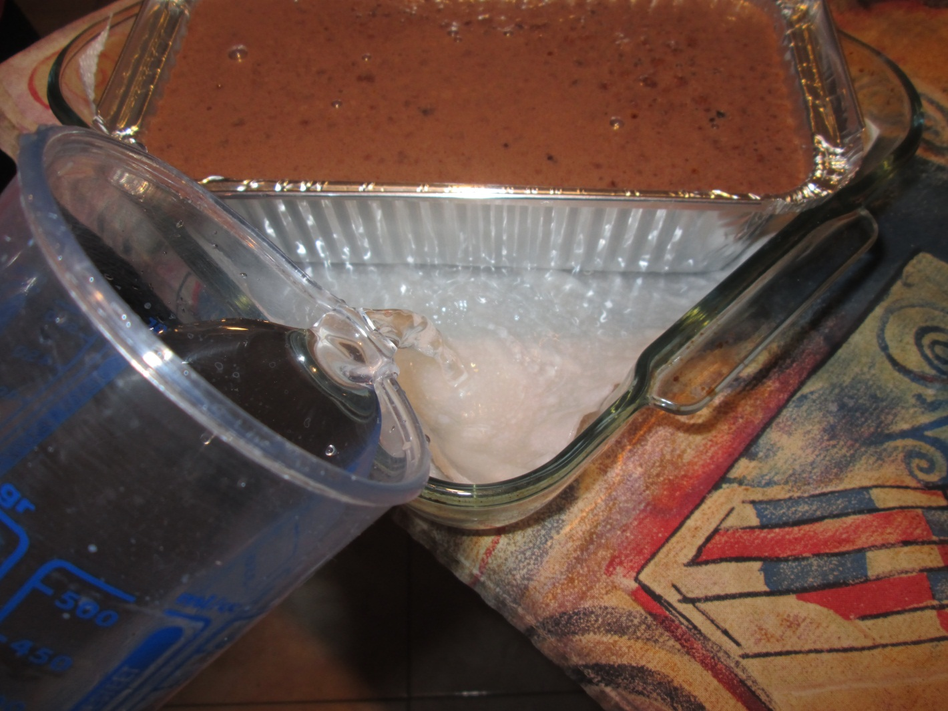
Pour all the content into the mould
Put the mould into the heat-resistent dish and add the water up to 1/3 of its height

Slide 9
Put it in the oven at 180° C for about one hour

Slide 10
Take out of the oven and wait for it to cool. Put it in the fridge for about two hours, then decorate with the hazelnuts and some amaretti

Slide 11
…….et voilà !

