Slide 1
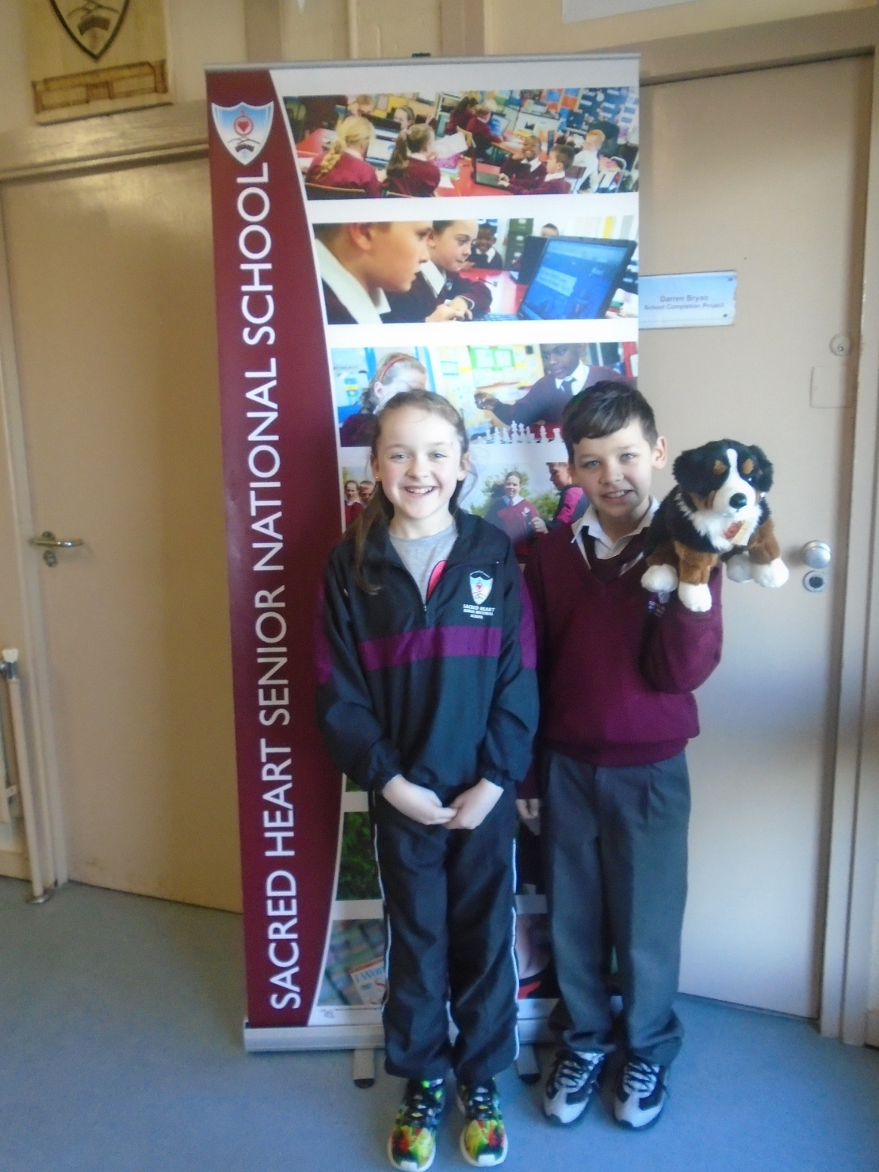
Our School
Starring DIFI

Slide 2
This is where we live: in Dublin

Slide 3
Here I am in the classroom

Slide 4
We have a school garden

Slide 5
Here I am in one of the computer rooms

Slide 6
This is the other computer room

Slide 7
The pupils like to work together doing projects

Slide 8
Sometimes our parents come in and we do “Reading for Fun”

Slide 9
Here we are in the school library

Slide 10
This is one of my favourite rooms: the kitchen!

Slide 11
This is the main hall: I’m sitting on two hurleys!

Slide 12
This is the games room: we come here now and again

Slide 13
I love to go home with the children
We have done our homework, so we can watch television!

